Slide 1
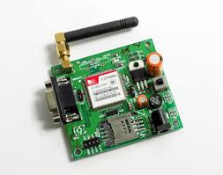
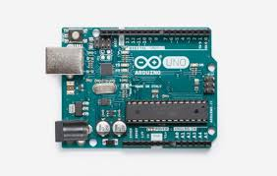
IOT based Smart irrigation system
Team Name: TECHDOSE
Team members:
Shubham Agarwal
Harish Pradhan
Abhishek Kumar
Virendra pratap singh jhala

Slide 2
Problem Identification
Farmers lose their precious effort, time, money and crops due to lack of knowledge about the proper irrigation techniques:
Farmers are unaware about the appropriate requirement of water for their crops.
Different crops need different amount of water.

Slide 3
Farmers don’t get appropriate information about the environment of their growing crops.
Different stages of a plant requires different amount of water.
High percentage of moisture in a soil sometimes leads to unfertility.

Slide 4
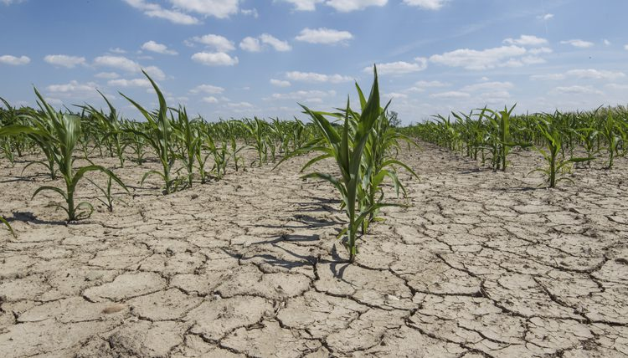
Effects :
Salinisation of soil due to excessive irrigation.

Slide 5
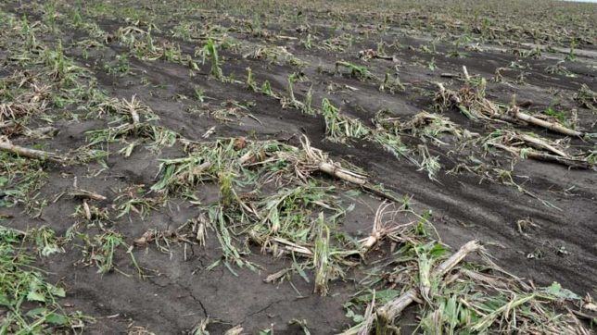
Lack of proper irrigation and crop maintenance (dryness).
Crop destruction due to over irrigation.

Slide 6
Infertility in soil due to over irrigation.
Sometimes due to lack of efforts, it results in dryness of soil and subsequent loss in fertility.
Statistics:
This problem has already destroyed 3 million hectares of land only in North India.

Slide 7
Solution
If farmers know the appropriate way to irrigate their field , this can help them for the good yield of their crops which eventually helps them to put less effort and time and earn more money.
Smart Irrigation system helps to solve the above mentioned problems.

Slide 8
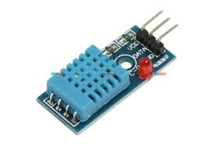
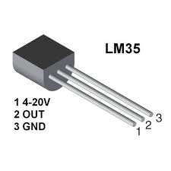
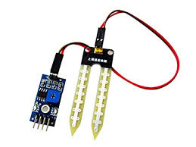
Equipments required:
Arduino UNO
humidity sensor
soil moisture sensor
LM35 temperature sensor
GSM modem
Bread Board
16*2 display

Slide 9
By using IOT we can measure the following things in the real time :
Moisture of soil
Temperature of soil.
Humidity of environment.

Slide 10
Working Scenarios:
Farmers will set the required moisture level for their crops.
Through the IOT it will measure the above mentioned things and compare it with the requirements.
If the soil does not meet the demand it will warn the farmer to take appropriate action regarding it.

Slide 11
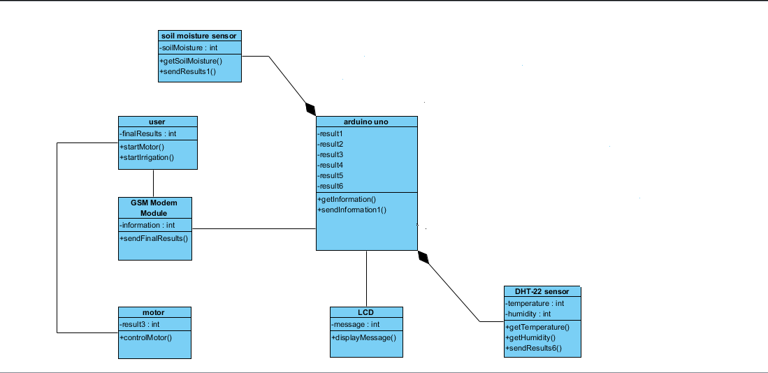
Block Diagram of the whole working scenario

Slide 12
Practicability/Applicability/Feasibility:
This technique is practically feasible and applicable in real life for farmers as it consumes a onetime investment (It will be used only at the time of farming and has less chance of being out of work) with no certain specific maintenance.
Moreover it may be provided to farmers through government subsidy which will further reduce the cost of investment for farmers.

Slide 13
The cost expense of this technique is approximately around Rs.2000 but due to mass production its cost will get reduced dramatically which will help the government further more to avail it to farmers at much lower costs.

Slide 14
Conclusion:
Through this smart method of WARNING, farmers know about their soil health for the particular type of crops, this lead to the successful growth of their crops.
Farmers get the real time information regarding the requirements of their plants for the need of irrigation.

